Slide 1
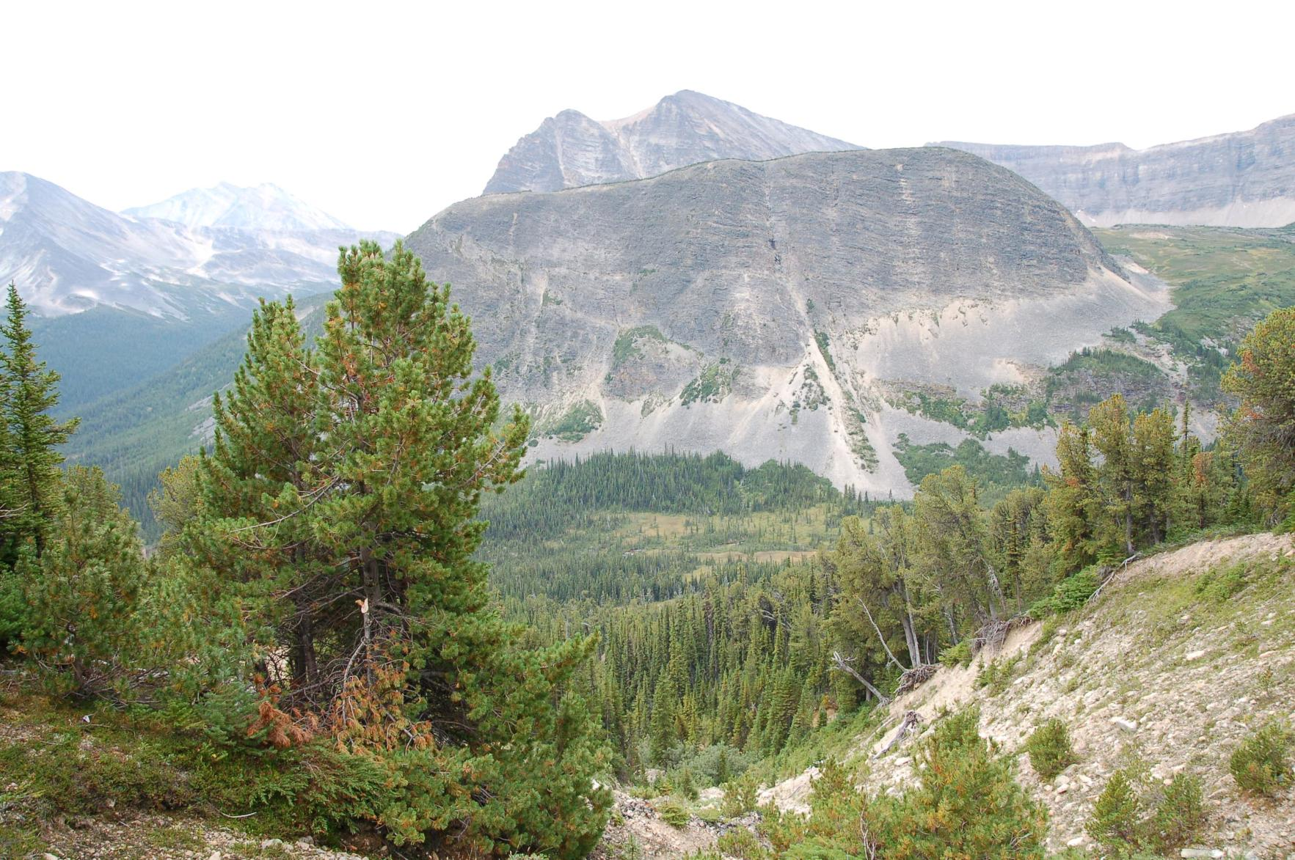
Whitebark pine: Ecology, Threats, and Why We Care
Whitebark Pine Ecosystem Foundation
www.whitebarkfound.org
Diana F. Tomback, Director
Diana.Tomback@ucdenver.edu
Photo credits: D. F. Tomback
Unless noted otherwise.
Willmore Wilderness Provincial Park

Slide 2
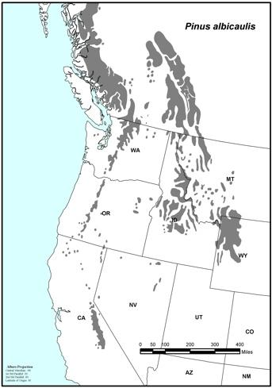
Whitebark pine (Pinus albicaulis)
Upper subalpine and treeline conifer.
Widely distributed throughout western North Amerca.
37º to 55º N lat.
107 to 128º W long.
2

Slide 3
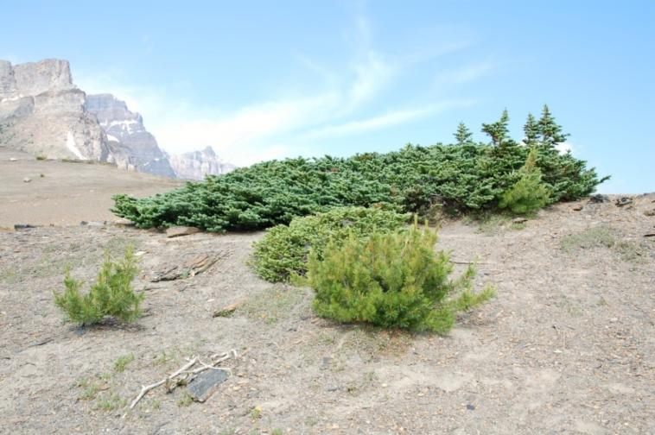
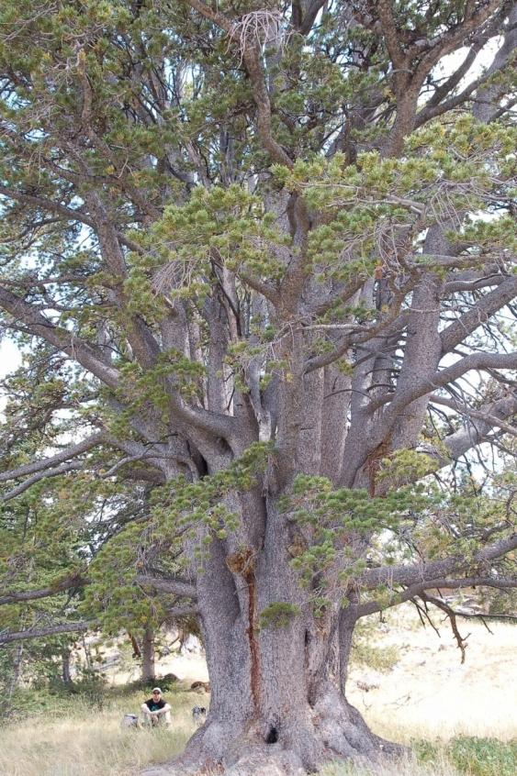
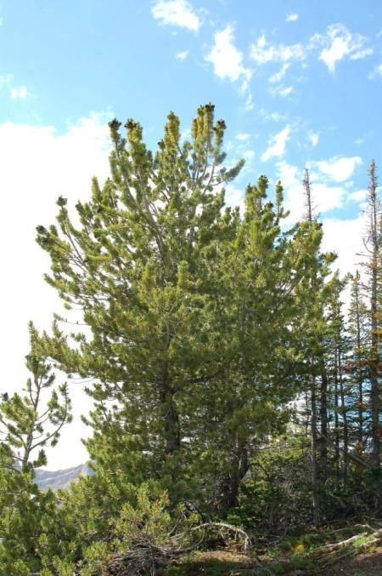
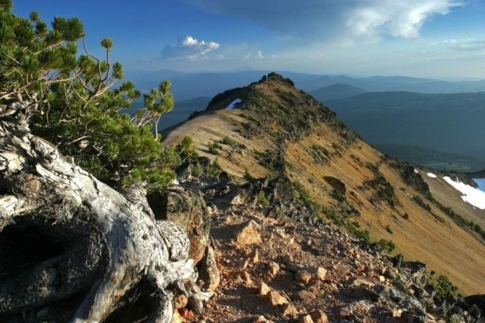
Banff National Park Alberta, Canada
Whitebark pine
growth forms
Wind River Mountains, WY
Crater Lake National Park, OR, Rob Mutch
3
Banff National Park

Slide 4
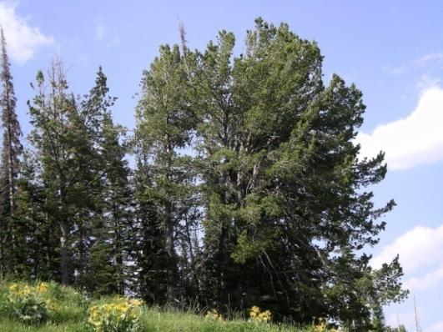
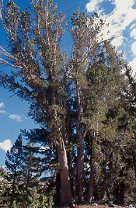
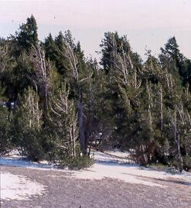
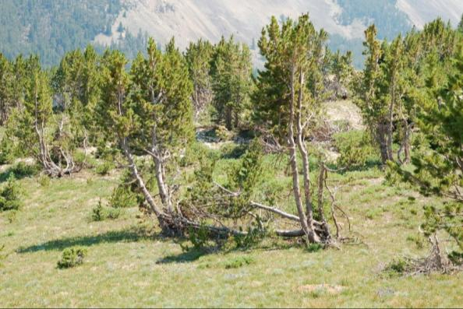
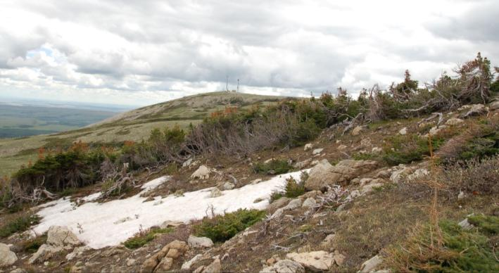
Grand Teton National Park, WY
Whitebark pine across its range
Yosemite National Park, CA
Crater Lake National Park OR
Beartooth Plateau, MT
Blackfeet Indian Reservation, MT

Slide 5
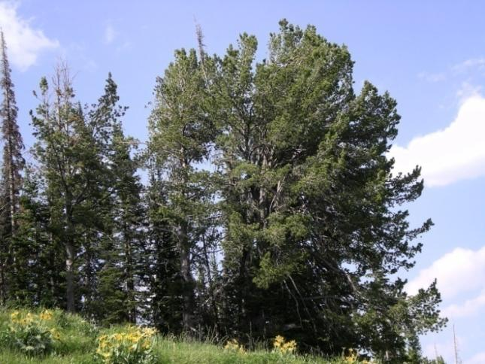
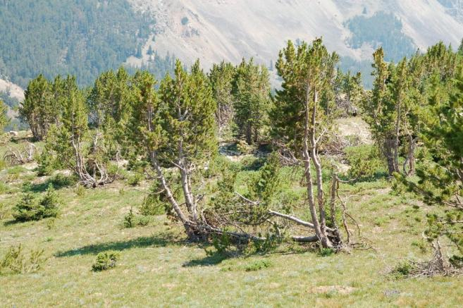
Whitebark pine community structure
Successional communities on favorable sites, upper subalpine zone (widespread in the Rocky Mountains)
Climax communities on exposed upper subalpine sites and in treeline ecotone (most common)

Slide 6
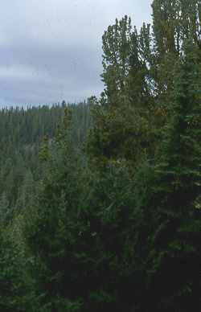
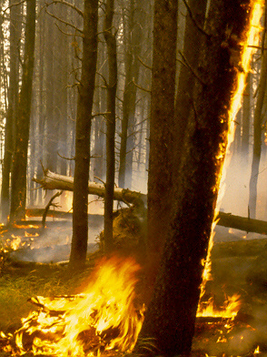
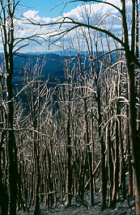
Successional communities on favorable sites: renewed by fire

Slide 7
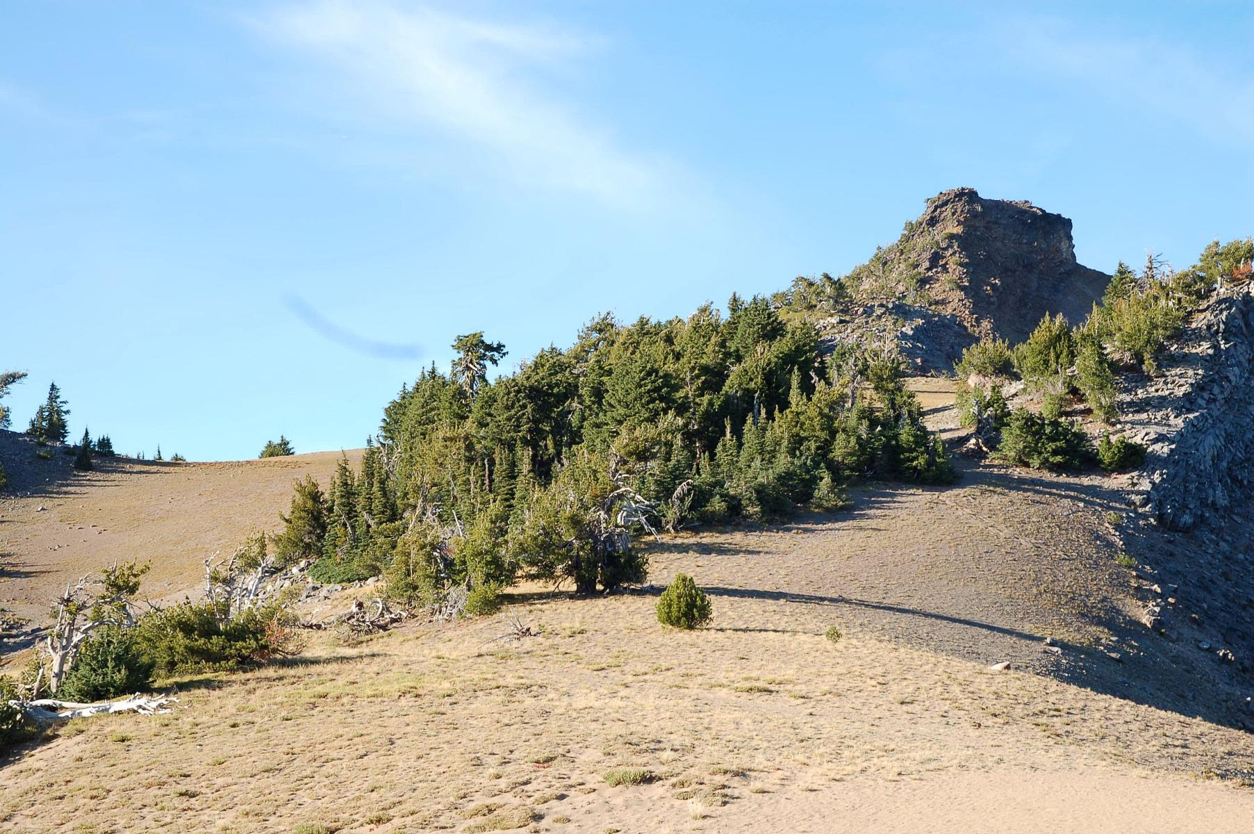
Climax communities of the upper subalpine and treeline ecotone
Whitebark pine tolerates
cold, dry conditions
Crater Lake National Park

Slide 8
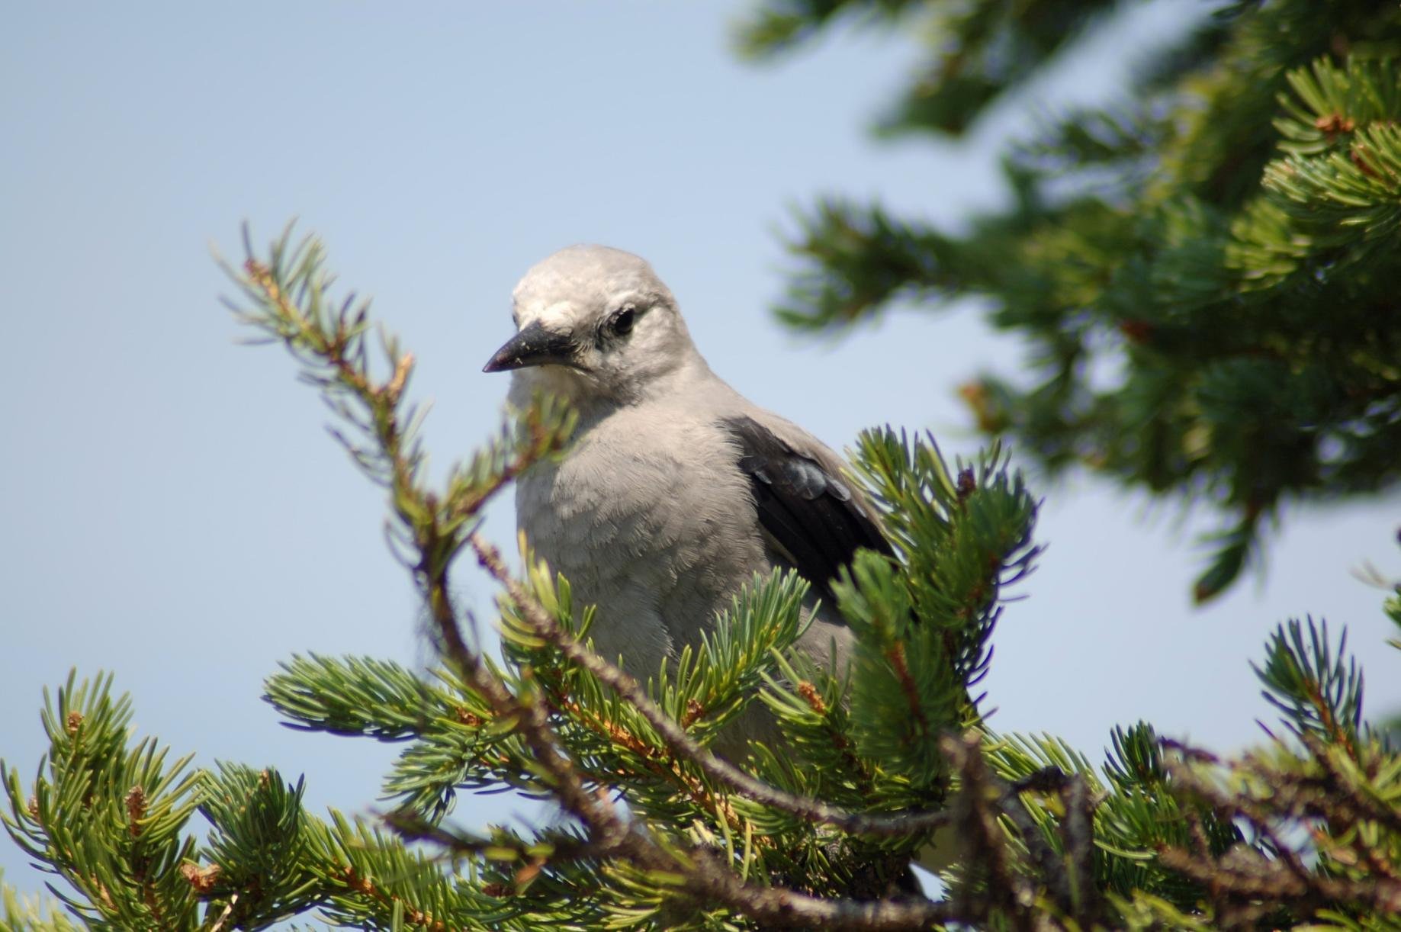
Clark’s Nutcracker is the
primary seed disperser
for whitebark pine

Slide 9
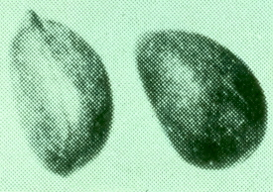
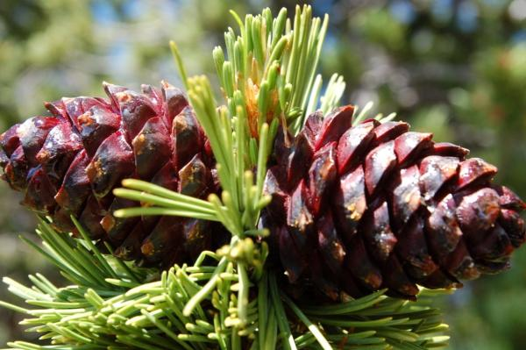
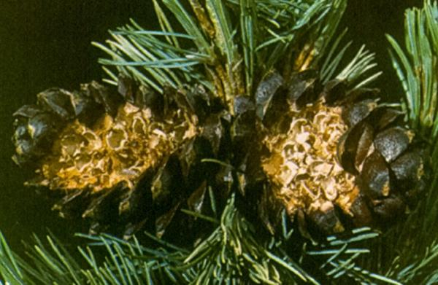
Adaptations of whitebark pine for seed dispersal by nutcrackers
Wind cannot disperse seeds because:
Cones remain closed upon seed ripening
Seeds are large and wingless
Horizontally-oriented cones on
upswept branches attract nutcrackers
Krugman & Jenkinson 1974
why matters
what is really meant

Slide 10
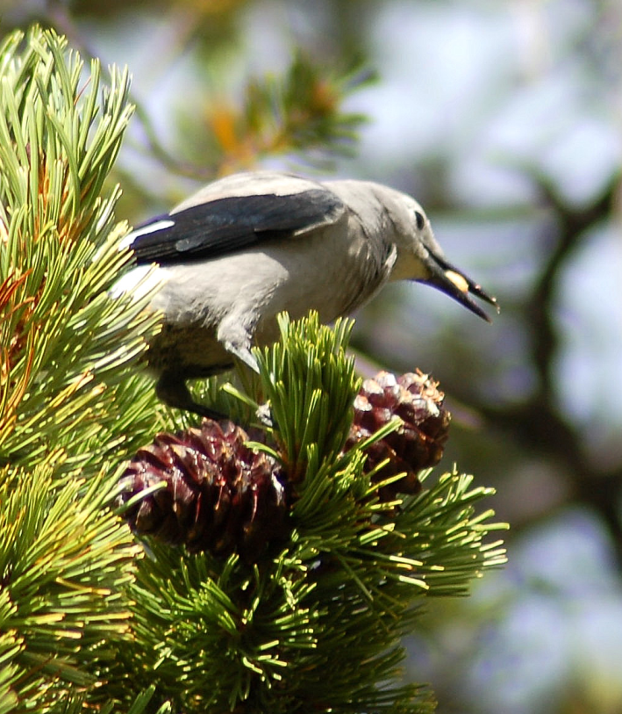
Seed dispersal by nutcrackers
Nutcrackers
Carry up to 150 seeds in sublingual pouch.
Bury seeds in caches of 1-15+ seeds, typically 3 or 4.
Bury seeds 1 to 3 cm under soil, needle litter, or gravel.
Carry seeds a few meters to 12 km (max. known 35 km).
Each bird can store 35,000 to 98,000 seeds each year.
Retrieve caches using highly accurate spatial memory.
Unretrieved caches may germinate, leading to regeneration.

Slide 11
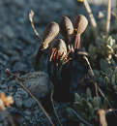
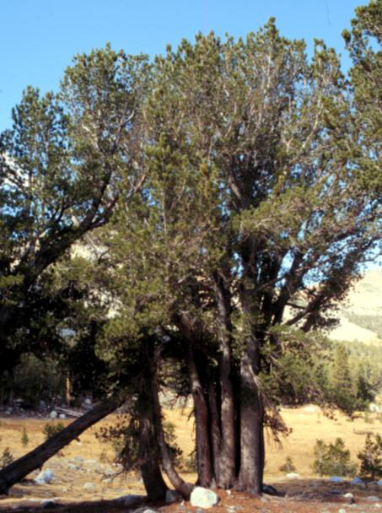
Seed dispersal by nutcrackers
Responsible for distribution of whitebark pine on landscape--
both elevation and topography
Treeline may rise with climate change- because nutcrackers cache seeds from the lower subalpine to above current treeline.
“Tree cluster” growth form results from multi-seed caches
Population genetic structure at multiple scales
both elevation and topography.
Tree cluster growth form

Slide 12
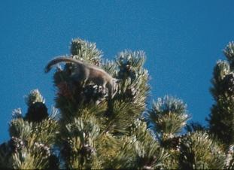
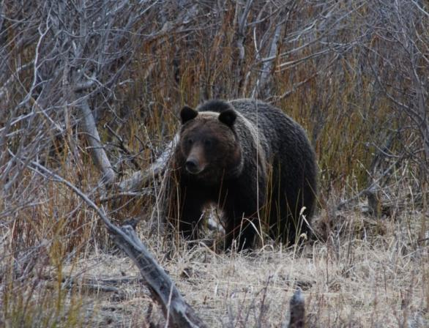
Whitebark pine seeds are an important wildlife food
Whitebark pine seeds are eaten by:
Birds: 7 families, 13 species
Small Mammals: 2 families, 8+ species
Large Mammals: 1 family, 2 species: Grizzly and black bears
When seeds are ripe, good cone crop, canopies busy with foraging birds and chipmunks and squirrels.
S. Wirt

Slide 13
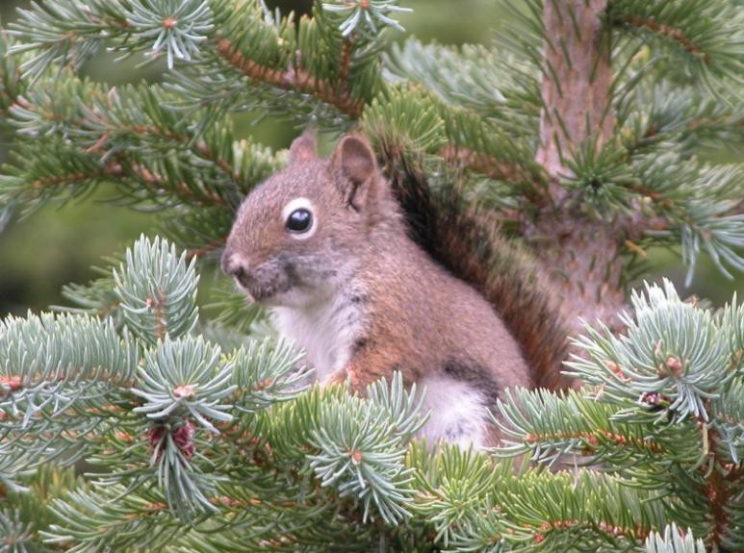
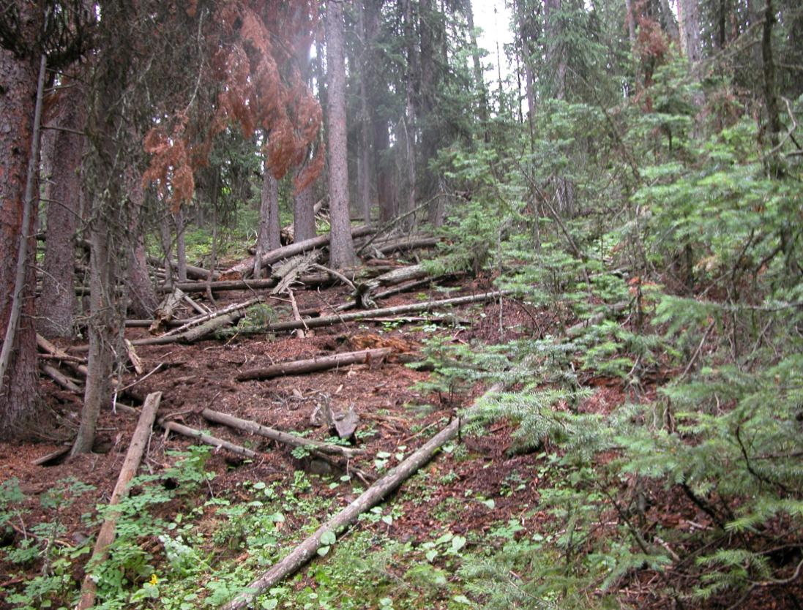
Red squirrels
Major competitors for whitebark pine seeds.
Cut down whitebark pine cones for winter food.
Squirrels bury cones in middens in their territories.

Slide 14
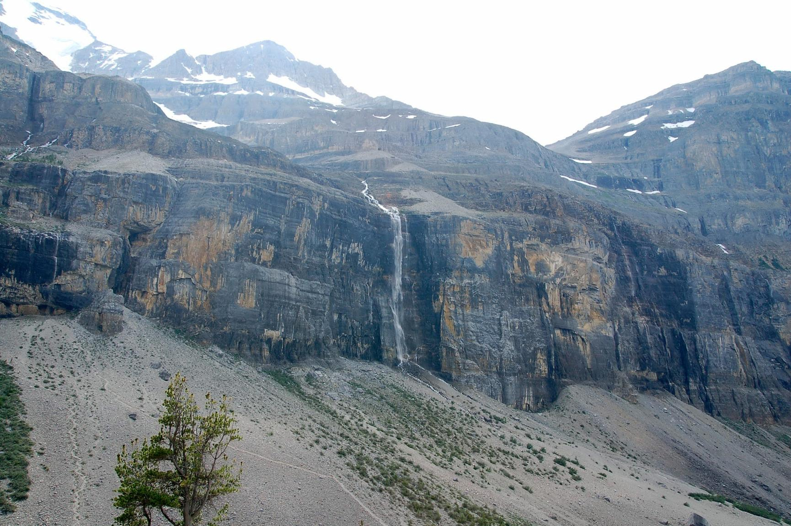
Whitebark pine--the high mountain
keystone and foundation species:
Why we need it!
Promotes biodiversity
Wide spectrum of community types
Provides wildlife habitat, shelter, and
nest sites.
Seeds provide wildlife food.
Stanley Glacier , Kootenay NP

Slide 15
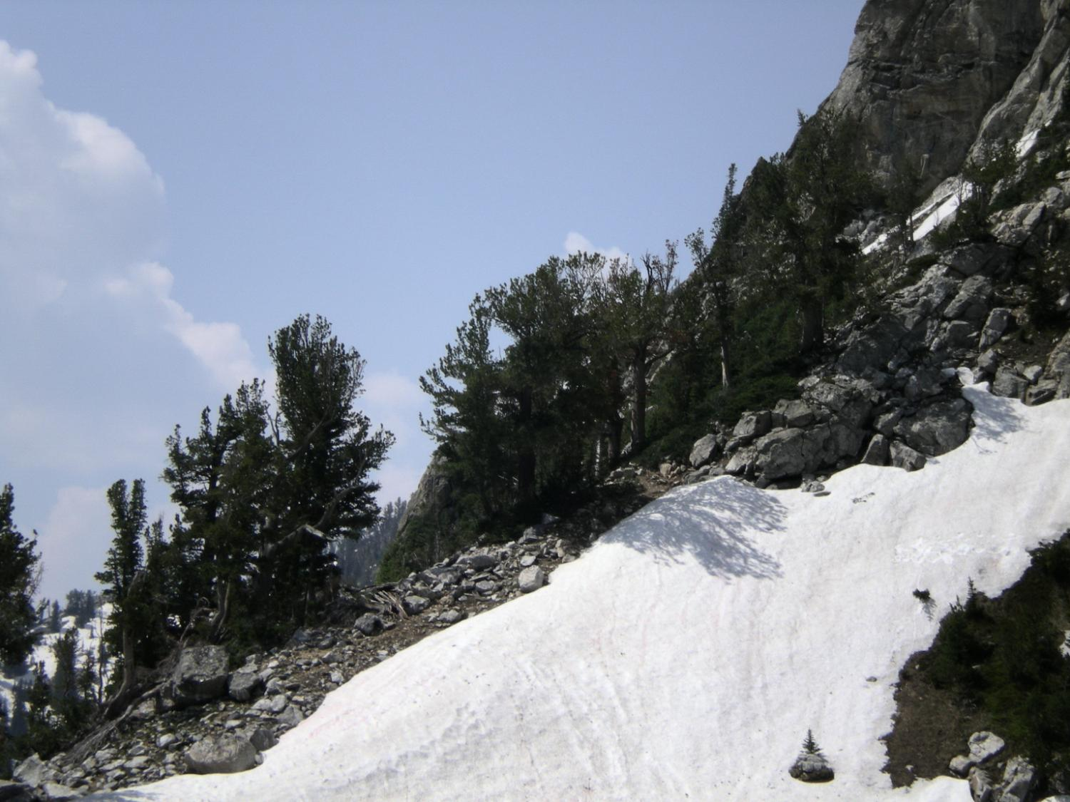
Ecosystem services:
Community development and stability; protects our “water towers”
Regulates snow melt and downstream flow.
Reduces soil erosion; stabilizes snow---avalanche control.
Fosters plant community development after disturbance.
Nurse tree on harsh sites.
Tree island initiator and component.
Because nutcrackers cache above treeline, whitebark pine may respond quickly to climate change.
Grand Teton National Park

Slide 16
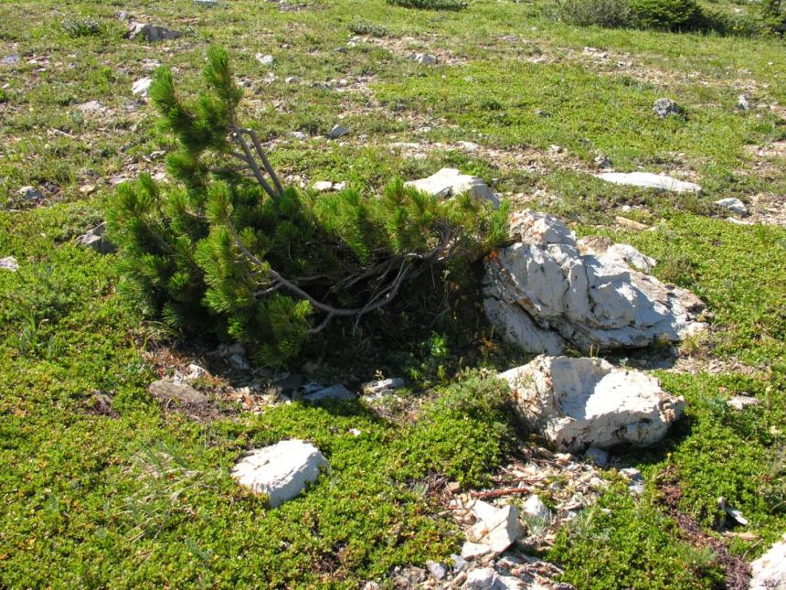
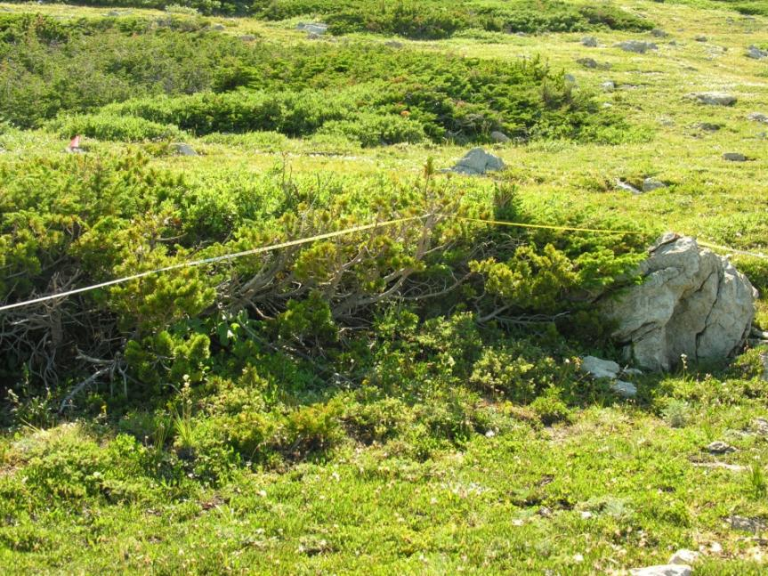
Building a tree island

Slide 17
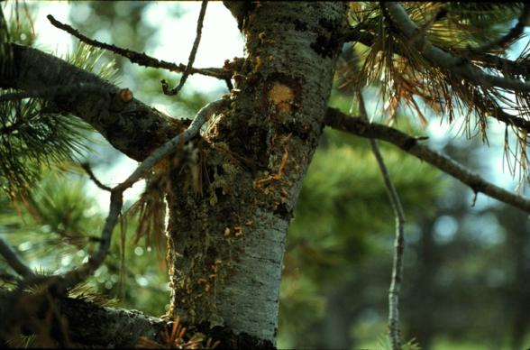
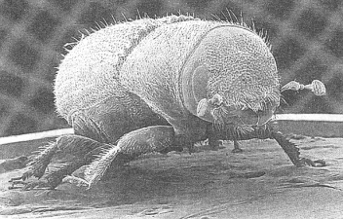
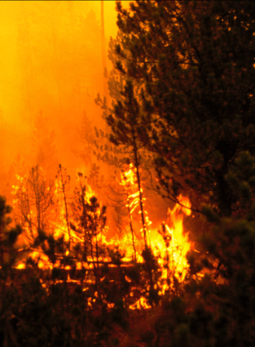
Whitebark pine “in peril”
The introduced, invasive pathogen, Cronartium ribicola—white pine blister rust.
Mountain pine beetle outbreaks.
Altered fire regimes—successional replacement.
Climate warming— sustaining pine beetle outbreaks, producing drought stress and mortality, and altering pine distributions.

Slide 18
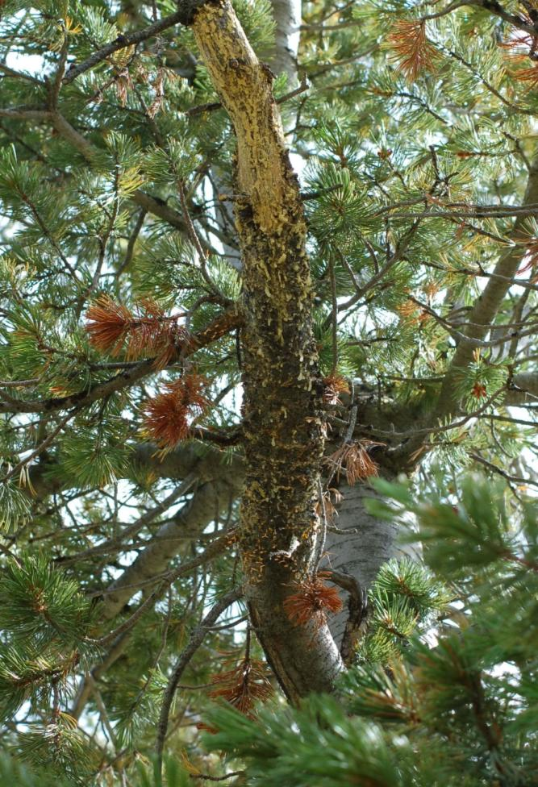
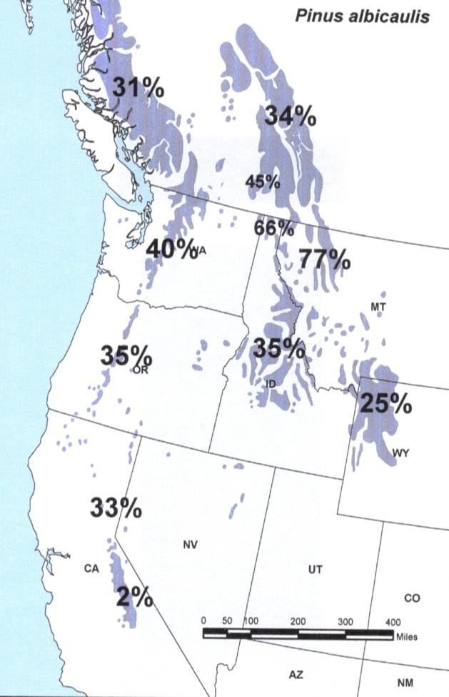
White pine blister rust
0%
Average percent blister rust infection across each region

Slide 19
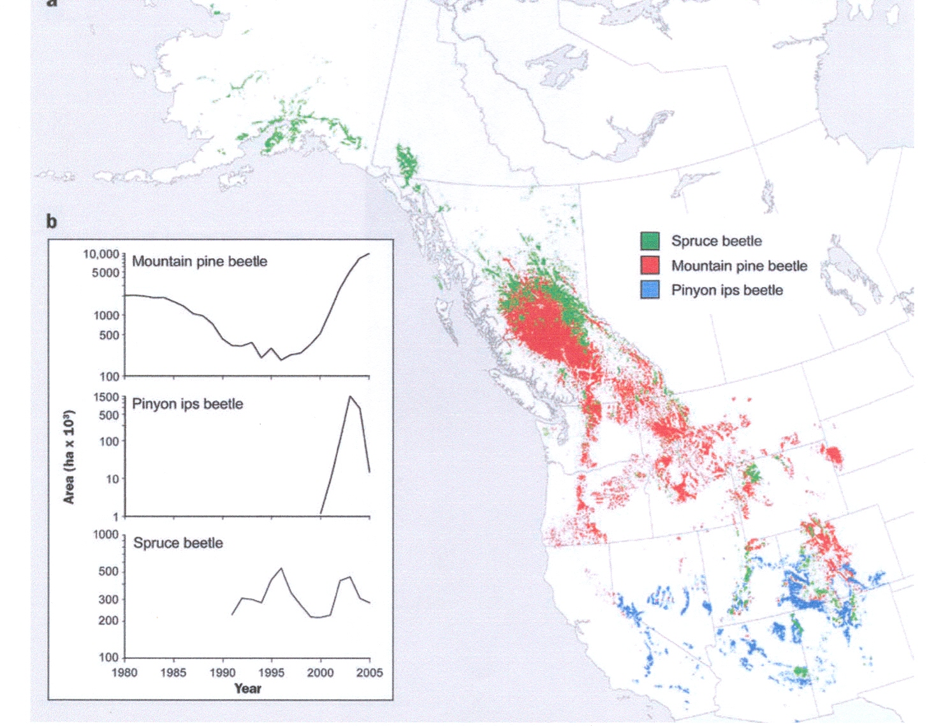
Total acres with mountain pine beetle-killed whitebark pine across the Western U.S. as of 2007: 470,000 with up to 90% mortality.
(Gibson et al. 2008)
Raffa et al. 2008

Slide 20
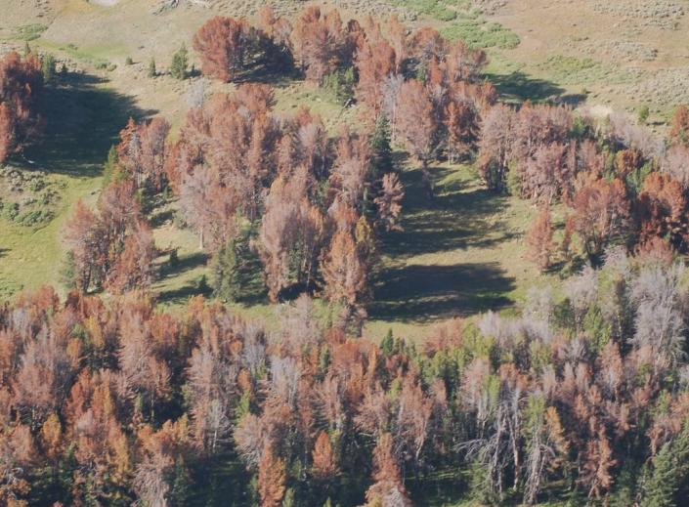
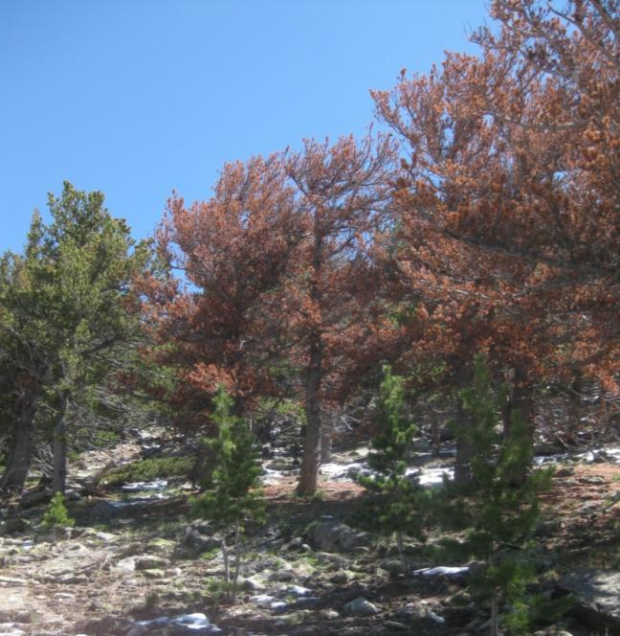
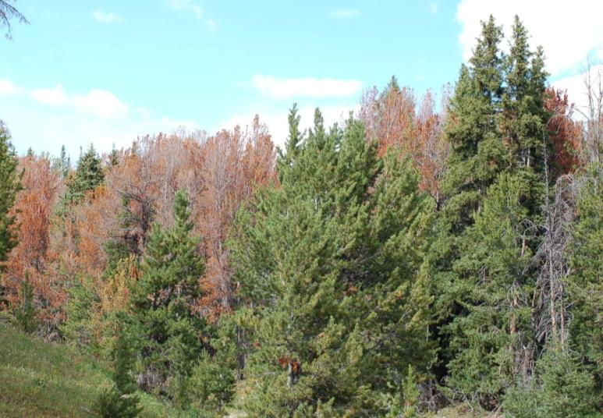
Mountain
pine beetle

Slide 21
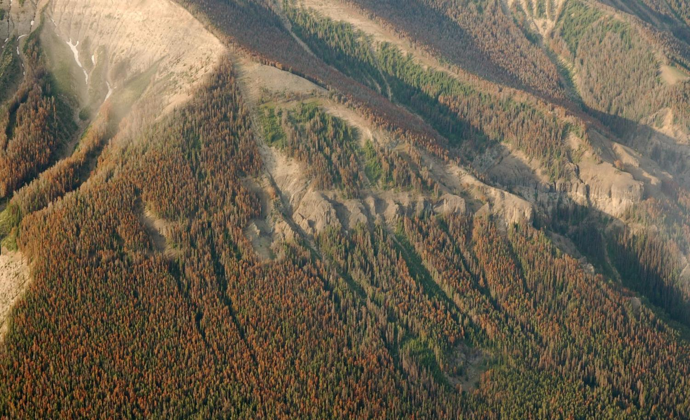
Avalanche Peak,
Yellowstone National Park, EcoFlight

Slide 22
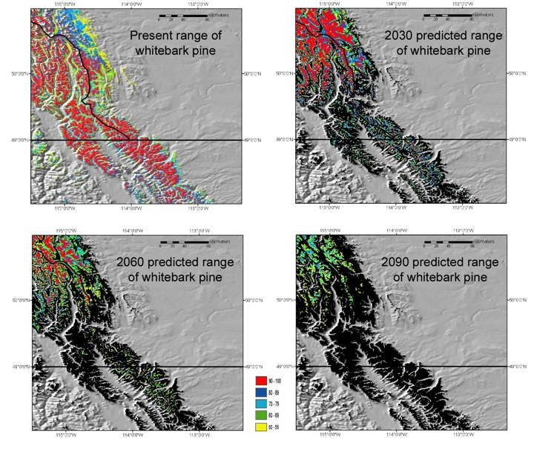
(Warwell et al. 2007)
Notes:
These predictions do not take blister rust into consideration, so the rate at which we see WBP disappear as a treeline and subalpine component, may be faster than even these preditctions suggest.
Rehfeldt et al. xxxx). develop bioclimatic models that predict the occurrence of plant communities and some of their constituent species, and (2) project contemporary climate profiles into future climate space. Rehfeldt et al. (xxxx) predicted that whitbark pine distributions would decrease along a S – N and low to high elevational trend (Fig.2). Each color codes a proportion of votes from Random Forest analysis received by a pixel in favor of being within the climatic niche of the species.

Slide 23
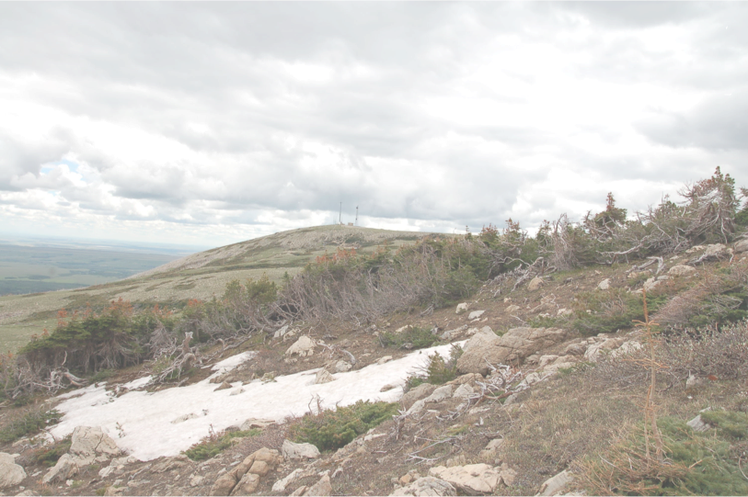
Without whitebark pine:
Grizzlies wander widely in search of pre-hibernation food.
Forest regeneration takes longer after fire.
On harsh sites, less treeline vegetation.
The “water towers” are not as effective.
Treeline response to climate change delayed.
Whitebark pine is so widely distributed, its extinction or even local extirpation will have significant consequences for forest composition, ecological function and ecosystem services.
Blackfeet Tribal Lands, MT

Slide 24
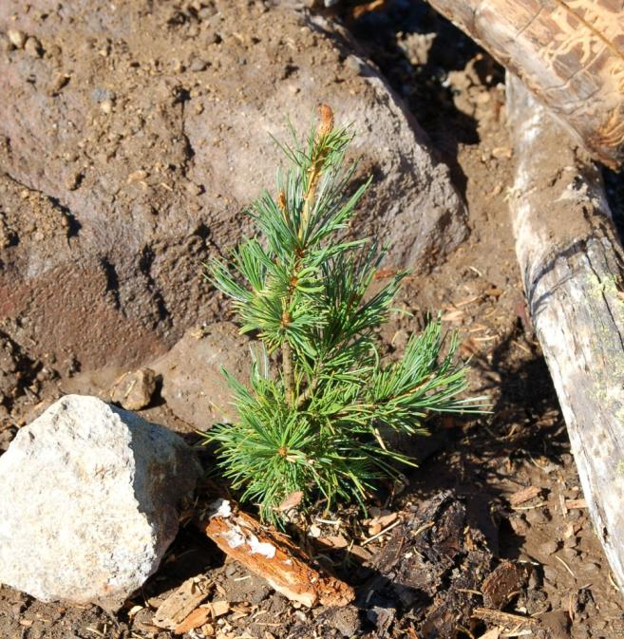
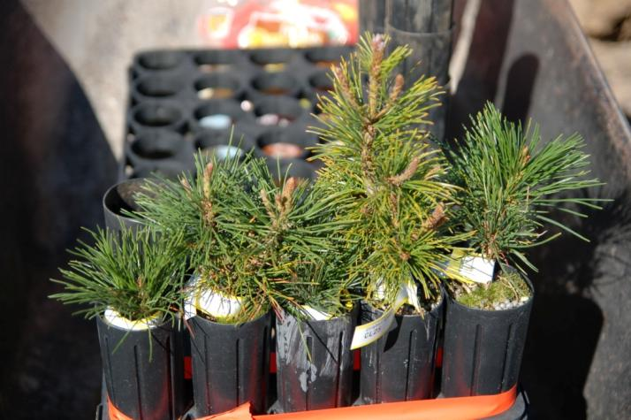
Whitebark pine restoration
Strategy: speed up natural selection by developing and planting blister-rust resistant seedlings.
Replace the seed dispersal services of nutcrackers.

Slide 25
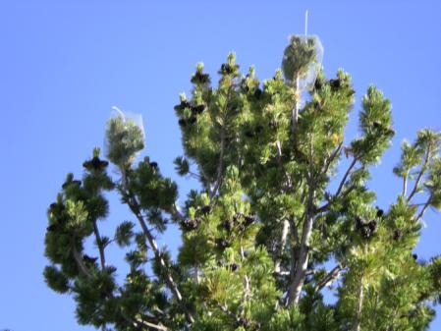
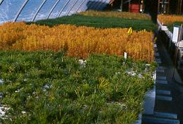
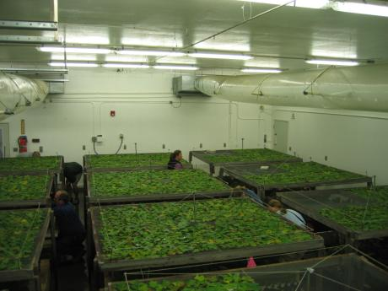
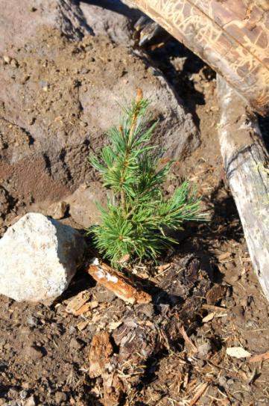
Steps in restoration
Protect ripening cones. Harvest cones.
Grow seedlings.
Screen seedlings
for resistance.
Plant seedlings.
Protect resistant seed sources against mountain pine beetles.

Slide 26
In July 2011, after full status review by U.S. Fish and Wildlife Service, whitebark pine was named a Candidate Species for listing under the Endangered Species Act. Cited: blister rust, mountain pine beetles, fire exclusion, climate change.
In June 2012, whitebark pine was listed as endangered in Canada under the Species at Risk Act.
Thank you for supporting our efforts to promote restoration and education about whitebark pine. To learn more or to donate to our cause: www.whitebarkfound.org

